Slide 1
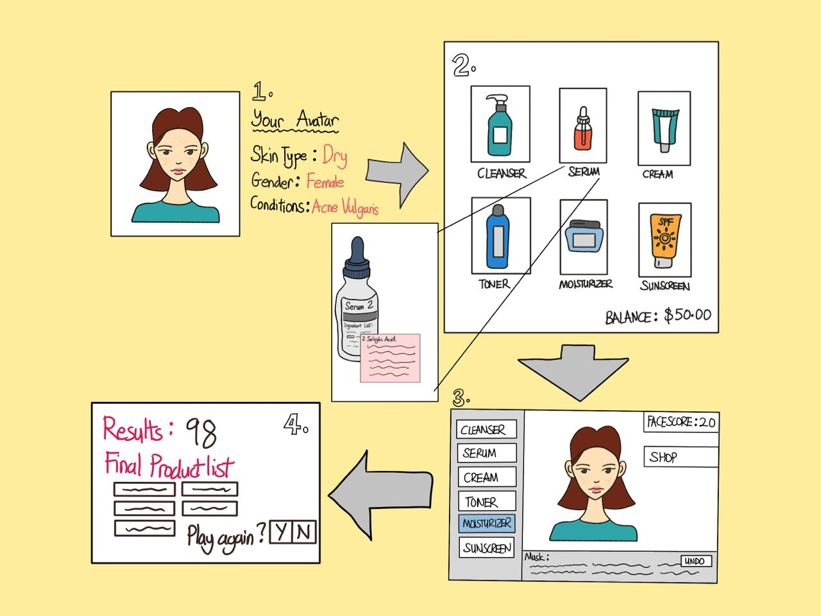
Customisable avatar: The player can make his/her own avatar with similar skin conditions
Shop that allows player to buy any product they want, given a fixed budget
Product description to allow player to learn more about the types of products, and find out which products will be more suitable for the player.
Face score of avatar which is impacted by 2 factors:
Suitability of products
Order in which products are applied
Back to Shop Button for other products
Undo button for player to try out different sequences of applying the product
List of products previously bought by player for avatar

